Slide 1
Lecture 1
Design and Analysis of Algorithms (CSET-244)

Slide 2
3 Hours Lectures
1 Hour Tutorial
4 Hours Practical
Course Structure

Slide 3
Evaluation Policy
Components of Course Evaluation | Marks
Mid Semester Examination | 20
End Semester Examination | 40
Lab (Continuous Evaluation) * | 20
This project is based on the problems presented in the Smart India Hackathon (SIH). | 10
Hackathon | 5
Certification*** | 5
Total | 100

Slide 4
Foundation of the course (Prerequisite)
Data Structures
Programming

Slide 5
References
Books:
S.no | Book Title | Authors | Press
1. | Introduction to Algorithms | Thomas H. Cormen, Charles E. Leiserson, Ronald L. Rivest, Clifford Stein | MIT Press
2. | Algorithm Design | Jon Kleinberg & Eva Tardos | Pearson
3. | Computer Algorithms | Ellis Horowitz, Sartaj Sahni, Sanguthevar Rajasekaran | Computer Science Press

Slide 6
References
Other Resources:
Google
Geekforgeeks for practising questions and assignments.
Class Lectures

Slide 7
Lab Assignments
Programming language to follow: C++

Slide 8
Broad list of topics to be covered in the course
Basic of algorithms.
Sorting algorithms.
Divide and Conquer paradigm.
Greedy algorithms.
Dynamic programming.
Graph algorithms.
Computational classes.

Slide 9
Algorithm
The word “Algorithm” comes from the name of a Persian author, Abu Jafar Mohammad Ibn Musa Al-Khwarizmi.
An algorithm is a finite set of instructions that if followed, accomplishes a particular task.

Slide 10
Algorithm
Informally, an algorithm is any well defined computational procedure that takes some value, or set of values as input and produces some value or a set of values as output.
An algorithm is thus a sequence of computational steps that transforms the input into output.

Slide 11
Alternative Definition of Algorithm
An algorithm can also be viewed as a tool for solving a well specified computational problem.
The statement of a problem specifies in general terms the desired input-output relationship.
The algorithm describes a specific computational procedure for achieving that input-output relationship.

Slide 12
Properties of an Algorithm
Input
Output
Finiteness
Definiteness
Effectiveness

Slide 13
Input
An algorithm must receive some input data supplied externally.

Slide 14
Output
An algorithm must produce at least one output as the result.

Slide 15
Finiteness
No matter what is the input, the algorithm must terminate after a finite number of steps.
For example a procedure which goes on performing a series of steps infinitely is not an algorithm.

Slide 16
Definiteness
The steps to be performed in the algorithm must be clear and unambiguous.

Slide 17
Effectiveness
One must be able to perform steps in the algorithm without applying any intelligence.
For example, the step – select three numbers which form a Pythagorean triplet is not effective.

Slide 18
Program
A Program is the expression of an algorithm in a programming language.

Slide 19
Types of Algorithms
Iterative (Use loops and Conditional Statements)
Recursive (Use Divide and Conquer Approach)

Slide 20
Algorithm Design Techniques
Brute-force or Exhaustive Search
Divide and Conquer
Greedy Algorithms
Dynamic Programming
Branch and Bound Algorithms
Randomized Algorithms
Backtracking
Approximation Algorithms

Slide 21
Types of Problems solved by Algorithms

Slide 22
Types of Problems solved by Algorithms (Cont.)
Sorting is by no means the only computational problem for which algorithms have been developed.
Practical applications of algorithms are ubiquitous and include the following examples:
The Human Genome Project has made great progress toward the goals of identifying all the 100,000 genes in human DNA, determining the sequences of the 3 billion chemical base pairs that make up human DNA, storing this information in databases, and developing tools for data analysis. Each of these steps requires sophisticated algorithms.

Slide 23
Types of Problems solved by Algorithms (Cont.)
The Internet enables people all around the world to quickly access and retrieve large amounts of information. With the aid of clever algorithms, sites on the Internet are able to manage and manipulate this large volume of data. Examples of problems that make essential use of algorithms include finding good routes on which the data will travel and using a search engine to quickly find pages on which particular information resides.

Slide 24
Types of Problems solved by Algorithms (Cont.)
Electronic commerce enables goods and services to be negotiated and exchanged electronically, and it depends on the privacy of personal information such as credit card numbers, passwords, and bank statements. The core technologies used in electronic commerce include public-key cryptography and digital signatures which are based on numerical algorithms and number theory.

Slide 25
Types of Problems solved by Algorithms (Cont.)
Manufacturing and other commercial enterprises often need to allocate scarce resources in the most beneficial way. An oil company may wish to know where to place its wells in order to maximize its expected profit.
A political candidate may want to determine where to spend money buying campaign advertising in order to maximize the chances of winning an election.

Slide 26
Types of Problems solved by Algorithms (Cont.)
An airline may wish to assign crews to flights in the least expensive way possible, making sure that each flight is covered and that government regulations regarding crew scheduling are met.
An Internet service provider may wish to determine where to place additional resources in order to serve its customers more effectively.

Slide 27
Types of Problems solved by Algorithms (Cont.)
We are given a road map on which the distance between each pair of adjacent intersections is marked, and we wish to determine the shortest route from one intersection to another. The number of possible routes can be huge, even if we disallow routes that cross over themselves. How do we choose which of all possible routes is the shortest?

Slide 28
Types of Problems solved by Algorithms (Cont.)
We are given a mechanical design in terms of a library of parts, where each part may include instances of other parts, and we need to list the parts in order so that each part appears before any part that uses it. If the design comprises n parts, then there are n factorial possible orders.

Slide 29
Types of Problems solved by Algorithms (Cont.)
We are given n points in the plane, and we wish to find the convex hull of these points. The convex hull is the smallest convex polygon containing the points. Intuitively, we can think of each point as being represented by a nail sticking out from a board. The convex hull would be represented by a tight rubber band that surrounds all the nails.

Slide 30
Study of Algorithms
The study of Algorithms includes many important and active areas of research which one can identify as:
How to devise Algorithms
How to validate Algorithms
How to analyze Algorithms
How to test a Program

Slide 31
Space Complexity
The space complexity of an algorithm is the amount of memory it needs to run to completion.

Slide 32
Time Complexity
The time complexity of an algorithm is the amount of computer time it needs to run to completion.

Slide 33
Performance Evaluation
It can be loosely divided into two major phases:
1. a-priori estimate – also known as performance analysis
2. a posteriori testing – also known as performance measurement.

Slide 34
Performance Measurement
It is concerned with obtaining the space and time requirements of a particular algorithm.
These quantities depend on the compiler and options used as well as on the computer on which the algorithm is run.

Slide 35
Importance of Design and Analysis of Algorithm:
Design and Analysis of Algorithm help to design the algorithms for solving different types of problems in Computer Science.
The Algorithm gives a clear description of requirements and goal of the problem to the designer.
To measure the behavior (or performance) of the methods in all cases (best cases, worst cases, average cases).
With the help of an algorithm, we can also identify the resources (memory, input-output) cycles required by the algorithm.
We can measure and analyze the complexity (time and space) of the problems concerning input size without implementing and running it; it will reduce the cost of design.

Slide 36

Case Study 1:
Dictionary: - Find a word in a dictionary. We may apply the following approaches: -
Approach 1: Linear Search
Approach 2: Binary Search

Slide 37
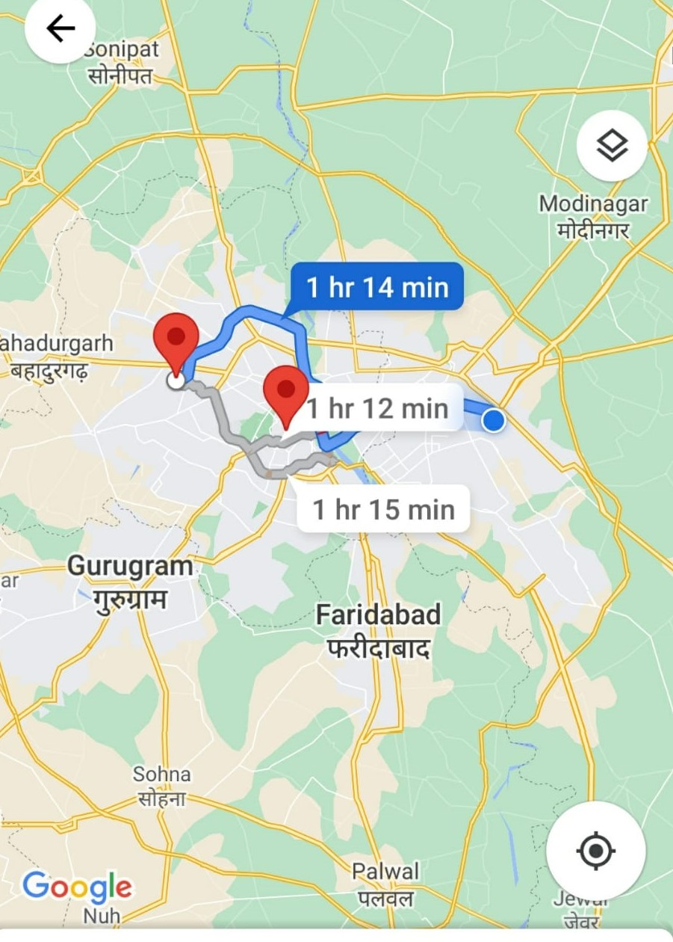
Case Study 2:
(ii) Google Maps: - Google maps to find the shortest path from place A to place B. Google maps also use the shortest route-finding algorithm. The Google map is based on a single-source shortest path algorithm (Dijkstra's algorithm).
Shortest Route as per time

Slide 38
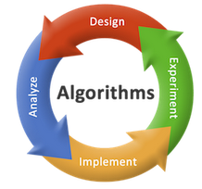
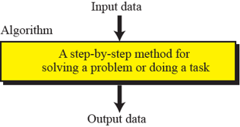
Definition of Algorithm
An algorithm is any well-defined computational procedure that takes some value, or set of values, as input and produces some value, or set of values, as output.
An algorithm is thus a sequence of computational steps that transform the input into the output.

Slide 39
How to Write Algorithm?
Natural Language
Flow Chart
Programming Language
Pseudo code

Slide 40
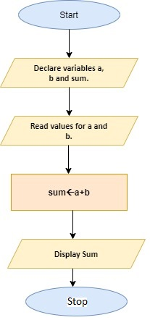
Natural Language Flow Chart
Step 1: Start
Step 2: Declare variables a, b and sum.
Step 3: Read values for a and b.
Step 4: Add a and b and assign the result to a variable sum.
Step 5: Display sum
Step 6: Stop

Slide 41
Programming Language Pseudo Code
int main()
{ int a, b, sum;
printf("Enter two numbers to add\n"); scanf("%d%d", &a, &b);
sum = a + b;
printf("Sum of the numbers = %d\n", sum);
return 0; }
BEGIN
Read a, b
Set sum to a+b
END:

Slide 42
Qualities of Good Algorithm:
The factors that we need to consider while determining the quality of a good Algorithm are:
Time: The amount of time it takes an algorithm to run as a function of the length of the input is known as time requirement. The number of operations to be done by the algorithm is indicated by the length of input.
Memory: The amount of memory utilized by the algorithm (including the inputs) to execute and create the output is referred to its memory requirement.
Accuracy: There can be more than one solution to the given problem, but the one which is the most optimal is termed as accurate.

Slide 43
How to Compare Algorithms
To compare algorithms, let us define a few objective measures:
Execution times? Not a good measure as execution times are specific to a particular computer.
Number of statements executed? Not a good measure, since the number of statements varies with the programming language as well as the style of the individual programmer.
Ideal solution? Let us assume that we express the running time of a given algorithm as a function of the input size n (i.e., f(n)) and compare these different functions corresponding to running times. This kind of comparison is independent of machine time, programming style, etc.

Slide 44
Performance Analysis:
The main goal to study this subject is to judge an Algorithm, as we already discussed that we can judge an algorithm on the basis of computing time and storage requirement.
Analysing the algorithm depend on the space (storage) complexity (space acquired by the algorithm) and time taken for algorithm execution (time complexity).

Slide 45
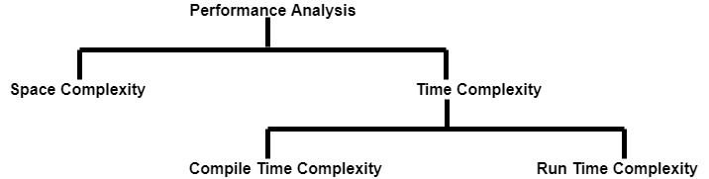
Categorization of Complexity:

Slide 46
Space Complexity:
Space Complexity of an algorithm is total space taken by the algorithm with respect to the input size.
Space complexity includes
Auxiliary space (Temporary Space)
Space used by input

Slide 47
Component to Calculate Space Required by the Algorithm: Space Complexity
1. Fixed Part
fixed part is space for code this is independent of the input and output. This part includes the instruction space, space for simple variables, space for constant, so on.
main()
{
int n =10;
printf(“%d”, n);
}
n has fixed value that is 10 and size of integer type data is fixed in Memory (2 for 32-bit compiler and 4 for 64 bit) compiler).

Slide 48
Component to Calculate Space Required by the Algorithm
2. Variable Part
Variable part that consists of the space needed by component variable whose size is dependent on the particular problem. This part includes space needed by referenced variables and the recursion stack space.
Algorithm fact(int n)
{
If (n==0)
return 1;
return n* fact(n-1);
}
Memory taken by the Algorithm fact is dependent upon the value of n.

Slide 49
Time Complexity
The time complexity T(P) taken by a program P is the sum of the compile time and run (execution) time. Compiler time does not depend on the instance characteristics. Also we assume that a compiled program will be run several times without recompilation. That is why we focus only on Run (Execution) Time.
Given the set of instruction (Pseudo code), Compute time complexity
Algorithm sum(a,n)
{
s=0.0;
for i=1 to n do
s=s+a[i];
return s;
}

Slide 50
Example 1:
Statement | Step/execution (s/e) | Frequency | Total step
Algorithm sum(a,n) | 0 | 1 | 0
{ | 0 | 1 | 0
s=0.0; | 0 | 1 | 0
for i=1 to n do | 1 | n+1 | n+1
s=s+a[i]; | 1 | n | n
return s; | 0 | 1 | 0
} | 0 | 1 | 0
Time complexity/ time taken by the above code = 0 + 0 + 0 + n+1 + n + 0 + 0 =2n + 1

Slide 51
Example 2:
Write a Code for Sum of n natural numbers:

Slide 52

Solution 1:
int fun1(int n)
{
int sum=0;
for(int i=1; i<=n; i++)
for(int j=1; j<=i; j++)
sum++;
return sum;
}
Time and Space Complexity

Slide 53
Solution 1:
int fun1(int n)
{
int sum=0;
for(int i=1; i<=n; i++)
for(int j=1; j<=i; j++)
sum++;
return sum;
}
Time Complexity= order of n^2
and
Space Complexity= order of 1 (constant)

Slide 54
Solution 2:
int sum =0;
int fun1(n)
{
If(n==1)
return 1;
sum = n+ fun1(n-1);
return sum;
}
Time and Space Complexity:

Slide 55
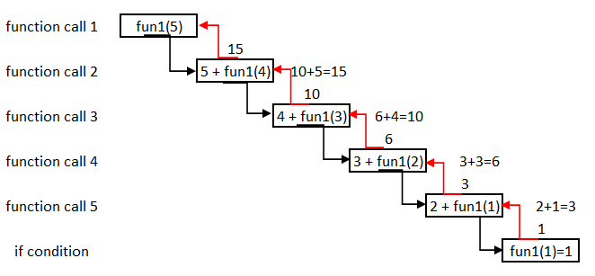
Solution 2:
int sum =0;
int fun1(n)
{
If(n==1)
return 1;
sum = n+ fun1(n-1);
return sum;
}
Time Complexity= order of n
and
Space Complexity= order of n

Slide 56
Solution 3:
int fun2(int n)
{
int sum=0;
for(int i=1;i<=n;i++)
sum=sum + i;
return sum;
}
Time and Space Complexity

Slide 57
Solution 3
int fun2(int n)
{
int sum=0;
for(int i=1;i<=n;i++)
sum=sum + i;
return sum;
}
Time Complexity= order of n
and
Space Complexity= order of 1

Slide 58
Solution 4:
int fun3(int n)
{
Return n*(n+1)/2;
}
Time and Space Complexity:

Slide 59
Solution 4
int fun3(int n)
{
Return n*(n+1)/2;
}
Time Complexity= order of 1
and
Space Complexity= order of 1

Slide 60
Solution 5:
int fun2(int arr[], int n)
{
Int sum=0;
for(int i=0;i<n;i++)
sum=sum +arr[i];
return sum;
}
Time and Space Complexity:

Slide 61
Solution 5:
int fun2(int arr[], int n)
{
Int sum=0;
for(int i=0;i<n;i++)
sum=sum +arr[i];
return sum;
}
Time Complexity= order of n
and
Space Complexity= order of n

Slide 62
Common Mathematical Functions used in Complexity Analysis:

Slide 63

Common Mathematical Functions used in Complexity Analysis
Constant Function f(n) = C
For any argument n, the constant function f(n) will execute some finite set of instructions only. The Algorithm that takes constant time does not depend on the input size.
for(i=0;i<100;i++)
{
printf(“%d”, *);
}
Time Complexity ??

Slide 64
Solution:
for(i=0;i<100;i++)
{
printf(“%d”, *);
}
for loop will execute 100 times every time. Execution of loop is fixed (constant) times.

Slide 65
Common Mathematical Functions used in Complexity Analysis
Logarithm Function f(n) = log n
For some change in input, the function grows as a function of logarithmic. This function is defined as follows:
Assume that n=25
Time Complexity ??
for(i=1;i<=n;2*i)
{
printf (“%d”, *);
}

Slide 66
Solution:
i | 2 | 4 | 8 | 16 | 32
True/ false | 2<25(true) | 4<25(true) | 8<25 (true) | 16<25(true) | 32>25(false)
for(i=1;i<=n;2*i)
{
printf (“%d”, *);
}
Now we can see that i increases in 2¹, 2², 2³, ……manner and the value of 2^{i}must be less or equal to n.
2^{i}<= n
Take log both side
i log 2<= log n
i <= (log n)/ (log 2)
i<= log₂n
Then the complexity of above example is order of log₂n.

Slide 67
Common Mathematical Functions used in Complexity Analysis
Linear Function f(n)= n
The Linear Function grows in a constant order. In another word it, it is a function which grows as a function whose graph can be plotted linearly.
for(i=0;i<n;i++)
{
printf(“%d”, *);
}
Time Complexity ??

Slide 68
Solution:
for(i=0;i<n;i++)
{
printf(“%d”, *);
}
For loop will execute n times from 1 to n. Hence, running time complexity will be n

Slide 69
Common Mathematical Functions used in Complexity Analysis
Function f(n)= n log n
This type of function growth is bounded between linear growth and those functions which grow to exactly square of the input provided.
for(i=0;i<n;i++)
{
for(j=2;j<n;2*j)
{
printf(“%d”, *);
}
}
Time Complexity ??

Slide 70
Solution:
Solution
There are two nested loops
When i=0 then second loop will execute log₂n times (already discussed).
Again, when i=1 then second loop will execute log₂n times again.
Similarly, first loop will execute n times and each time second loop will execute log₂n times.
So, the total execution is n* log₂n times.
So the complexity is order of n log₂n.
for(i=0;i<n;i++)
{
for(j=2;j<n;2*j)
{
printf(“%d”, *);
}
}

Slide 71
Common Mathematical Functions used in Complexity Analysis
Quadratic Function f(n)= n²
All those functions grow to like when we double the input size, and the function grows four times. For example, in nested loops,
for(i=0;i<n;i++)
{
for(j=0;j<n;j⁺⁺)
{
printf(“%d”, *);
}
}
Time Complexity ??

Slide 72
Solution:
for(i=0;i<n;i++)
{
for(j=0;j<n;j⁺⁺)
{
printf(“%d”, *);
}
}
There are two nested loops.
When i=0 then second loop will execute n times (already discussed).
Again, when i=1 then second loop will execute n times again.
Similarly, first loop will execute n times and each time second loop will execute n times.
So, the total execution is n* n times.
So, the complexity is order of n².

Slide 73
Common Mathematical Functions used in Complexity Analysis
Cubic Function and other Polynomial
This function grows faster than its counterpart that is Linear Search and quadratic equation. If we double the size of the input variable, then the function will grow eight times; hence the rate of growth will be cubic.
for(i=0;i<n;i++)
{
for(j=0;j<n;j++)
{
for(k=0;k<n;k++)
{
printf(“%d”, *);
}
}
}
Time Complexity ??

Slide 74
Solution:
for(i=0;i<n;i++)
{
for(j=0;j<n;j++)
{
for(k=0;k<n;k++)
{
printf(“%d”, *);
}
}
}
There are three nested loops.
When i=0 then second loop j=0 and third loop execute k=0 to n-1 times (total n times).
Again, when i=0 then second loop j=0, 1, 2, 3……n-1 will execute n times and k=0, 1, 2, 3……n-1.
Similarly, first loop will execute n times, second loop will execute n times and Third loop will execute n times.
So, the total execution is n* n* n times. So, the complexity is order of n³.

Slide 75
Common Mathematical Functions used in Complexity Analysis
Factorial Function f(n)=n!
The running time of this function is worst among all discussed till so far? If we are going to increase the value of n, then the function will grow using the concept of the Factorial function.
Permutation (a) = {a}
Permutation (ab) = {ab, ba}
Permutation (abc) = {abc, acb, bac, bca, cab,cba}
Time Complexity ??

Slide 76
Solution:
Permutation (a) = {a}
Permutation (ab) = {ab, ba}
Permutation (abc) = {abc, acb, bac, bca, cab,cba}
n=1, n! = 1! = 1
n=2, n! = 2! = 2*1 = 2
n=3, n! = 3! = 3*2*1 = 6

Slide 77
Growth Of Functions

Slide 78
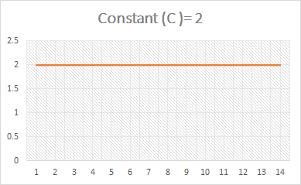
1. Constant (C)
Always order of 1. No matter value of C is 1, 10, 100, 1000 or any number

Slide 79
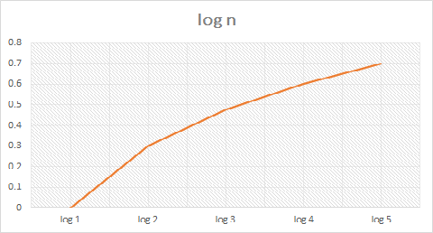
2. Logarithmic (log n)
Complexity is order of log n.
If n=1 then log(1)=0
If n=2 then log(2)=.3010
If n=3 then log(3)=.4771
If n=4 then log(2)=.6020
------
If n=10 then log(10)=1
Faster than constant( C )

Slide 80
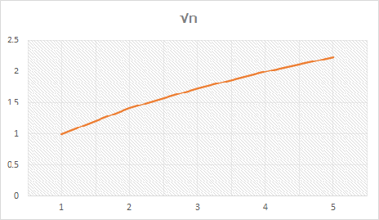
3. Square root
If n=1 then √1= 1
If n=2 then √2=1.414
If n=3 then √2=1.732
If n=4 then √4=2
-------
If n=16 then √16=4
Faster than logarithmic (log n)

Slide 81
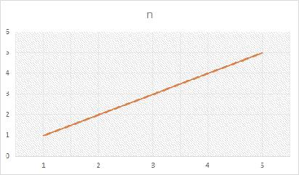
4. Linear
Complexity is order of n. Always grow in linear manner.
If n=1 then complexity is 1
If n=2 then complexity is 2
Complexity is dependent on the value of n, and n is variable. Faster than square root(√n)

Slide 82
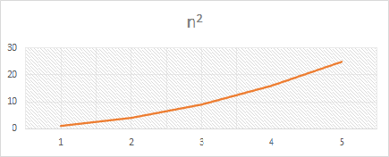
5. Quadratic (n^2)
Function growth is fast
If n=1 then complexity is 1
If n=2 then complexity is 4
If n=3 then complexity is 9
------
If n=6 then complexity is 36.
Hence, (n²)
Faster than Linear (n)

Slide 83
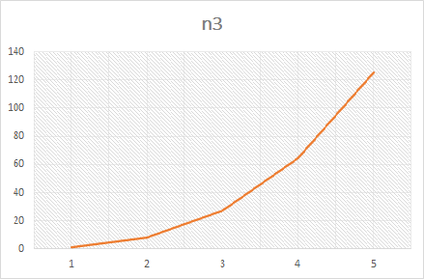
6. Cubic (n^3)
If n=1 then complexity is 1
If n=2 then complexity is 8
If n=3 then complexity is 27
----
If n=5 then complexity is 125
Faster than Quadratic (n²)

Slide 84
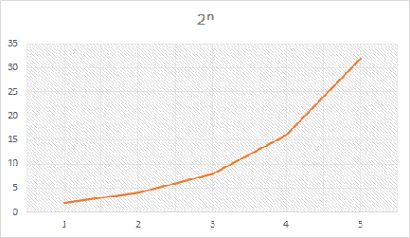
7. Exponential (2^n)
If n=1 then complexity is 2
If n=2 then complexity is 4
If n=3 then complexity is 8
If n=4 then complexity is 16
-----------
It is slow in starting but for larger value it is Faster than Cubic (n³)

Slide 85
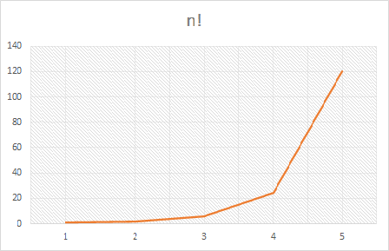
8. Factorial (n!)
If n=1 then complexity is 1=1
If n=2 then complexity is 2*1=2
----------------
If n=5 then complexity is 5*4*3*2*1 = 120
Faster than Exponential (2^{n})

Slide 86
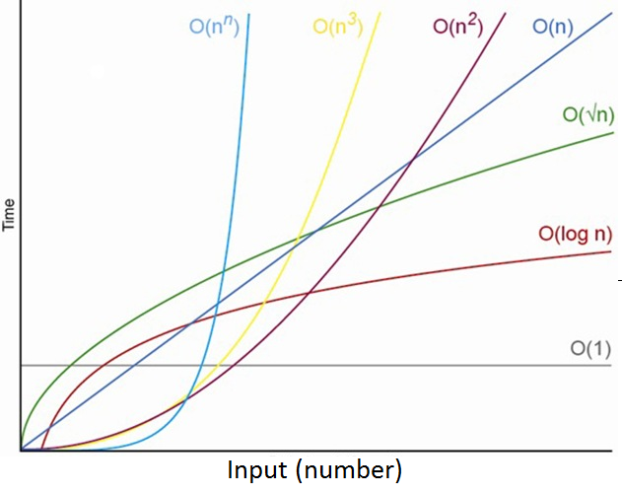
Growth of Functions
The growth of function provides the understanding of the Algorithm's efficiency in order to understand its performance. The aim is to predict the performance of different algorithms in order to predict their behaviour with changes in input.

Slide 87
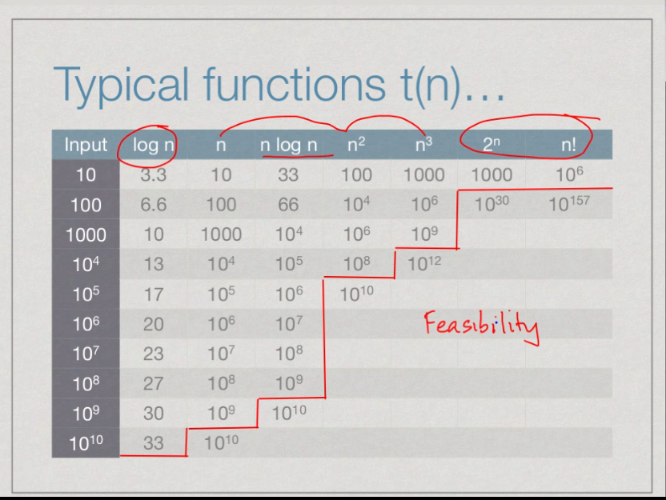

Slide 88
Conclusion
Comparison of various mathematical functions will result as follows:
Constant < log n < n < n²< n³ < 2^{n}< n!

Slide 89
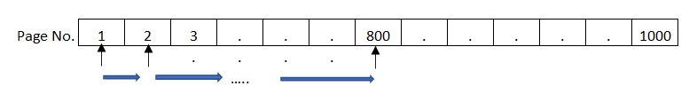
Why Analysis of Algorithms is important?
Let's understand the importance for performing the analysis of algorithm with the help of an example:
Example1: (Dictionary)
Let us assume that we have a dictionary of 1000 pages and we want to search a word “Space” in dictionary. This word is at 800thpage number.
First method: Turn the pages one by one and after turning 799 pages we got the word “Space”. In this method we made 799 comparisons.

Slide 90
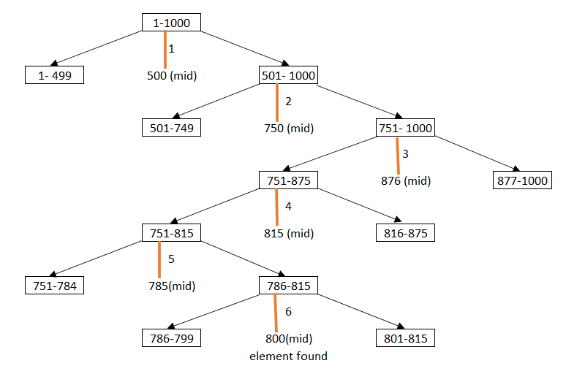
Why Analysis of Algorithms is important?
Second Method: Open the dictionary from the mid (500) now I know that word “Space” is in second half (501 to 1000), then again, I divide the pages (501-1000) from the mid (750). Now search the word between pages 750 to 1000. Repeat this step till reach page 800.

Slide 91
Why Analysis of Algorithms is important?
Red line represents the page number and number written with line represents the comparison.
With the help of this example, we can say that we need only 6 comparisons to reach page number 800, but in previous method 799 comparisons was required to reach page number 800.
Example 2:
As we have already discussed the example for writing different codes for sum of natural number in Day 3 PPT.
Solution 2:
Here we analyse each code in terms of time and space complexity

Slide 92
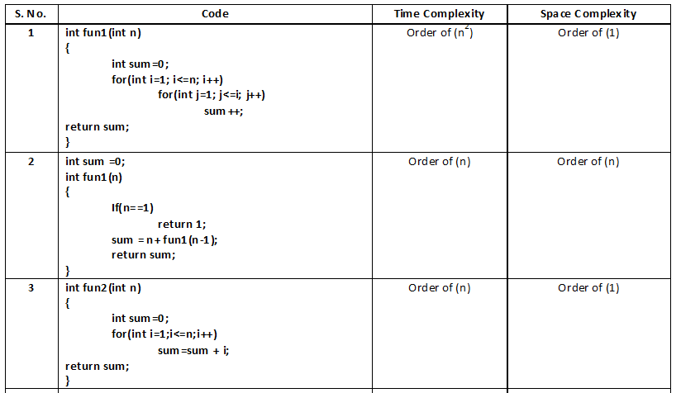
Analysis:

Slide 93
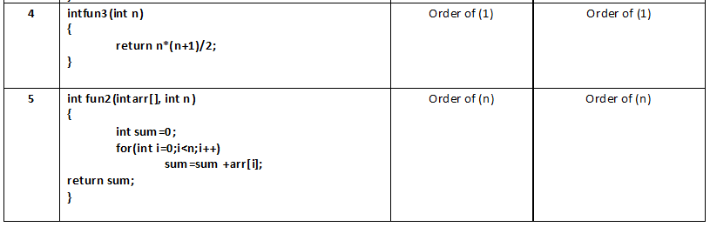
Analysis

Slide 94
Which method is better: Outcome of comparing different codes
In day-to-day life we solve many problems and there are many possible ways to solve any problem. To find a best possible solution among them is analysis of algorithm.
So, we can say that if we have any many possible solution of any problem and we analyse all the solution to select best one to reduce the complexity (made it easy) in terms of time and space

Slide 95
Different Cases of Analysing a Problem:

Slide 96

Different Cases to analyze any problem
In order to analyze the solutions of any problem we have to understand three cases:
Three cases to analyze any problem:
Best Case
Average Case
Worst Case
To understand these cases,
Problem 1: Consider given array of random elements, we have to categorize best, worst and average case. In this example, searching of an element is done.

Slide 97
Best Case:
Search element 5 in given array and check element one by one.
Start with index 0and found the element at first attempt.
What could be better than this that element found in first attempt? This is best condition to search any element.

Slide 98
Average Case:
Search element 15 in given array and check element one by one.
Start with index 0. First search at 0th index not found.
Search at 1st index not found
Repeat this step till element found.
Element 15 found at 4th index.
Size of array= 10 (0 to 9)
Number of comparisons required= 5 (0, 1, 2, 3, 4)
Almost half of the array size comparison required to search element (n/2 where n is size of array)
This is average case where we found the element after n/2 comparisons.

Slide 99
Worst Case:
Search element 4 in given array and check element one by one.
Start with index 0. First search at 0th index not found.
Search at 1st index not found
Repeat this step till element found.
Element 4 found at last index.
Size of array= 10 (0 to 9)
Number of comparisons required= 10 (0, 1, 2, ….9)
In this case we have traversed complete array and element found at last index.
Maximum comparison can be made is size of array this is worst case.

Slide 100
Searching another element in an array
Search element 19 in given array and check element one by one.
Start with index 0. First search at 0th index not found.
Search at 1st index not found
Repeat this step till element found.
Element 19 not found in array.
Size of array= 10 (0 to 9)
Number of comparisons required= 10 (0, 1, 2, ….9).
Element 19 is not in array but total number of comparisons made = maximum possible
comparison = array size.
This is also an example of worst case.

Slide 101
Conclusion:
Now conclusion is that
If Minimum number of steps (comparisons) required to solve a problem (Best Case).
If Average number of steps (comparisons) required to solve a problem (Average Case).
If Maximum number of steps (comparisons) required to solve a problem (Worst Case).

Slide 102
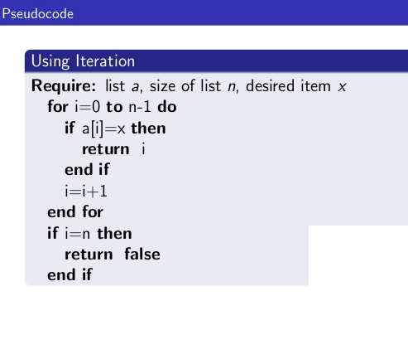
Introduction to algorithm
Definition :
It is a combination of sequence of finite steps to solve a problem.
Properties :
It should take zero or more input.
It should produce at least one output.
It should terminate after finite time.
Every state in the algorithm should be deterministic.
It should be programming language independent.

Slide 103
Steps Required to Construct Algorithm
Problem Definition
Design the Algorithm
Flow Chart
Verification (Testing)
Implementation (Coding)
Analysis

Slide 104
Analysis
Using time complexity and space Complexity we can analyze the algorithm.
Time Complexity:
T(A) = C(A) + R(A)

Slide 105
Types of Analysis
Posteriori Analysis (Relative Analysis) | Priori Analysis (Absolute Analysis)
1. It is programming language of compiler and type of processor dependent analysis | 1. It is programming language of compiler and type of processor independent analysis
2. Answer will change system to system | 2. Answer will not change system to system
3. Exact answer | 3. Approximate Analysis

Slide 106
Priori Analysis (Absolute Analysis)
“It is determination of order of magnitude of a statement.”
Example 1:
main()
{
x=y+z;
}

Slide 107
Example 2:
main()
{
x=y+z;
for (i=1; i<=n; i++)
{
x=y+z;
}
}

Slide 108
Example 3:
main()
{
x=y+z;
for (i=1; i<=n; i++)
x=y+z;
for (i=1; i<=n; i++)
{
for (j=1; j<=n; j++)
{
x=y+z;
}
}
}

Slide 109
Example 4:
main()
{
for (i=1; i<=n; i++)
{
for (j=1; j<=n/2; j++)
{
x=y+z;
}
}
}

Slide 110
Example 5:
main()
{
for (i =1; i<=n; i++)
{
for (j=1; j<=i; j++)
{
for (k=1; k<=133; k++)
{
x=y+z;
}
}
}
}

Slide 111
Example 6:
main()
{
while(n>=1)
{
n=n/2;
}

Slide 112
Example 7:
main()
{
i=1;
while(i<=n)
{
i=2*i;
}
}

Slide 113

Thank You

